Slide 1
INTERNAL HACKATHON 2026 DEPARTMENT OF COMPUTER SCIENCE
TITLE PAGE
Problem Statement Title: The stranger in your living room
Theme: SDG - Reduced Inequalities
PS Category- Software/Hardware: Software
Team Name: Entropy

Slide 2

IDEA TITLE
Entropy
Proposed Solution (Describe your Idea/Solution/Prototype)
Detailed explanation of the proposed solution:
AR-based assistive system for dementia patients
Uses camera + face recognition to detect people in front of the patient
Displays a minimal HUD with:
Name
Relation
One familiar routine
Plays a gentle one-time audio cue in the patient’s preferred language
Entire system works passively (no patient interaction required)

Slide 3
Entropy
How it addresses the problem?
Dementia patients often:
Recognize a person visually
But lose context (who they are, why they matter)
Loss of context → fear, panic, agitation
Cue restores:
Identity context (who)
Emotional safety (safe, familiar)
Reduces:
Patient anxiety
Repetitive explanations by caregivers
Preserves:
Dignity
Independence
Confidence in social interactions
Innovation and uniqueness of the solution
Focuses on context loss, not just memory loss
Combines:
Minimal AR HUD
One-time human-like audio reassurance
Silence-first design (does nothing when uncertain)
No periodic reminders → avoids cognitive overload
Multilingual, culturally aware voice support
Caregiver edits once, system works passively
Privacy-first:
Edge processing
No constant cloud dependency

Slide 4
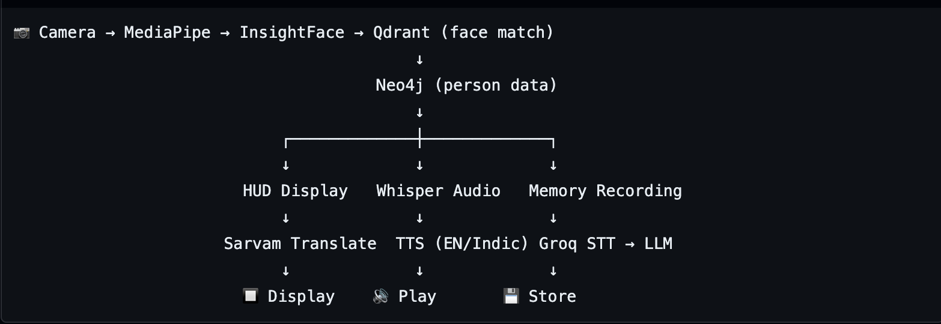
TECHNICAL APPROACH
Entropy
Component | Technology
Frontend | React + Vite
Face Tracking | MediaPipe
Backend | FastAPI
Face Recognition | InsightFace (buffalo_s, ONNX)
LLM | Groq (llama-3.3-70b-versatile)
Speech-to-text | Groq Whisper
Text-to-Speech | ElevenLabs (English) + Sarvam AI (Indian languages)
Translation | Sarvam AI (mayura:v1)
Vector DB | Qdrant Cloud
Graph DB | Neo4j Cloud
Flowchart

Slide 5
FEASIBILITY AND VIABILITY
Entropy
Analysis of the feasibility of the idea
Technical Feasibility
Uses existing, proven technologies
Face recognition (on-device / edge)
AR HUD (minimal overlay)
Speech-to-Text + Text-to-Speech
No custom hardware required for MVP
Can demo using camera + AR overlay
Template-based audio → predictable, safe output
Multilingual support via existing TTS engines
Operational Feasibility
Caregiver setup is one-time, not continuous
Patient interaction required: zero
Works in home-care and assisted-care settings
Scales from prototype → real deployment
Market Feasibility
Dementia cases are increasing globally
Current solutions focus on:
Reminders
Tracking
Potential challenges and risks
Patient-Related Risks
Some patients may:
Reject wearables
Be sensitive to voices
Experience hallucinations
Advanced dementia users may not benefit
Technical Risks
Face recognition errors (false positives)
Latency causing delayed reassurance
Low lighting / occlusion issues
Device battery or hardware failure

Slide 6

IMPACT AND BENEFITS
Entropy
Potential impact on the target audience
Dementia Patients
Reduces sudden fear and panic caused by inability to recognize familiar people
Restores context (who the person is, why they matter), not just names
Helps patients initiate conversations confidently
Preserves sense of identity and dignity
Creates a feeling of emotional safety in everyday interactions
Minimizes agitation caused by repeated confusion
Supports early to mid-stage dementia patients in
remaining socially active
Caregivers & Family Members
Reduces need for repetitive explanations (“This is your son”, “You know him”)
Lowers emotional burnout from constant reassurance
Allows caregivers to focus on care, not crisis management
Improves quality of interaction between patient and loved ones
Provides peace of mind during social encounters
Healthcare & Care Facilities
Helps manage dementia-related anxiety without medication
Reduces behavioral incidents caused by misrecognition
Can complement existing dementia care practices
Supports person-centered, non-invasive care models

Slide 7
IMPACT AND BENEFITS
Entropy
Benefits of the solution (social, economic, environmental, etc.)
Social Benefits
Promotes aging with dignity, not dependence
Encourages continued social engagement
Reduces stigma around memory loss
Supports multilingual and culturally diverse populations
Strengthens emotional bonds between patients and caregivers
Aligns with humane, ethical dementia care principles
Economic Benefits
Reduces caregiver time spent on repetitive reassurance
Potentially delays need for full-time supervision
Uses existing consumer hardware → low deployment cost
Software-driven solution → scalable and affordable
Reduces indirect costs linked to caregiver burnout
Environmental Benefits
No heavy hardware manufacturing
Minimal electronic waste
Low power consumption
Software-first approach reduces resource usage
Compatible with sustainable digital healthcare initiatives
Broader Societal Impact
Addresses a rapidly growing aging population
Provides a non-pharmaceutical intervention for dementia care
Encourages responsible use of AI in healthcare
Demonstrates how technology can restore human connection, not replace it

Slide 8
RESEARCH AND REFERENCES
Entropy
https://www.who.int/publications-detail-redirect/risk-reduction-of-cognitive-decline-and-dementia
https://chatgpt.com/share/696a4ef2-5234-8000-a700-692bcd3b0a02
https://chatgpt.com/share/69693ac0-7d50-8000-ac9b-391b1e6b540c

Slide 9
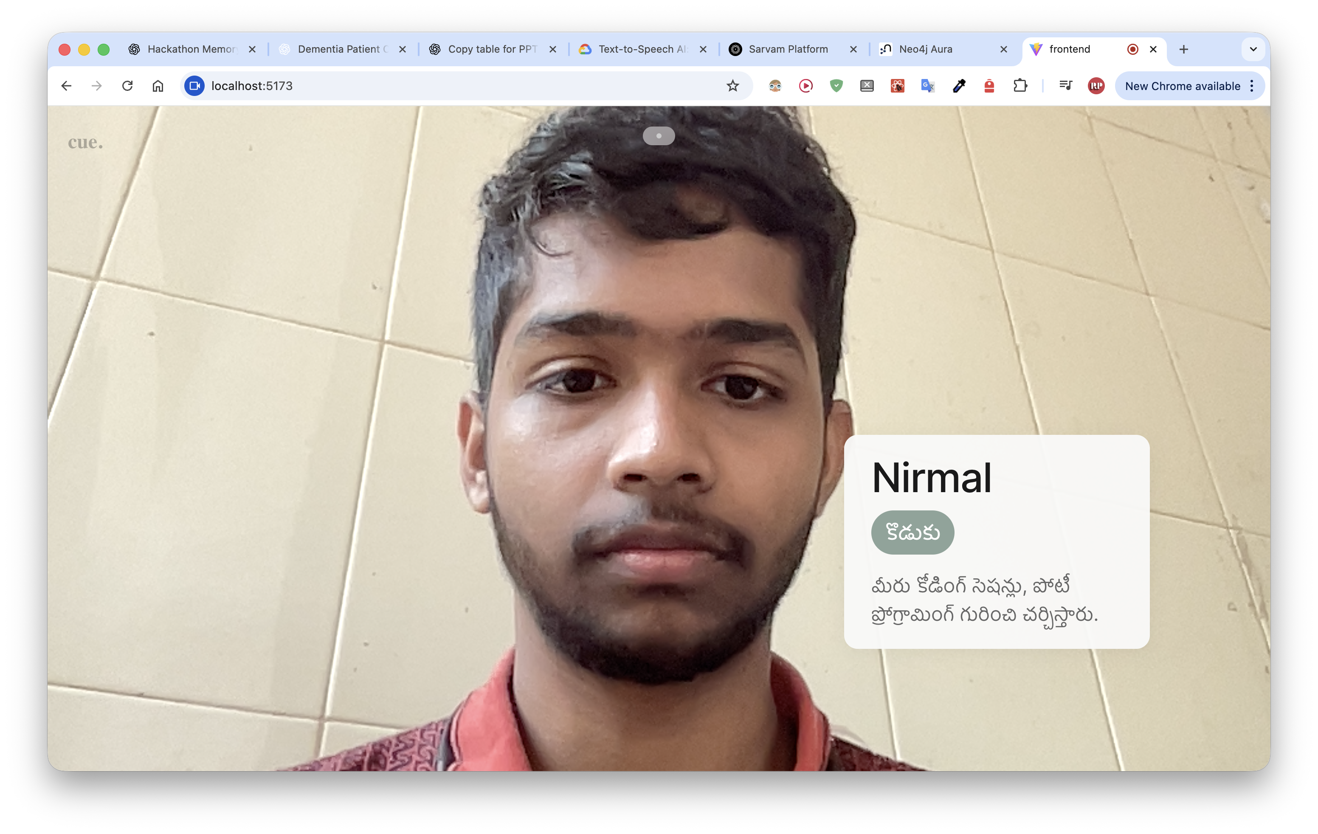
One Screenshot of DEMO
Entropy

Slide 10
IMPORTANT INSTRUCTIONS
Please ensure below pointers are met while submitting the Idea PPT:
Kindly keep the maximum slides limit up to six (10). ( Including the title slide)
Try to avoid paragraphs and post your idea in points /diagrams / Infographics /pictures
Keep your explanation precise and easy to understand
Idea should be unique and novel.
You can only use provided template for making the PPT without changing the idea details pointers (mentioned in previous slides).

